Slide 1
Prevalence & Impact of COVID-19 in Marion County, IN
Nicole Riggio

Slide 2
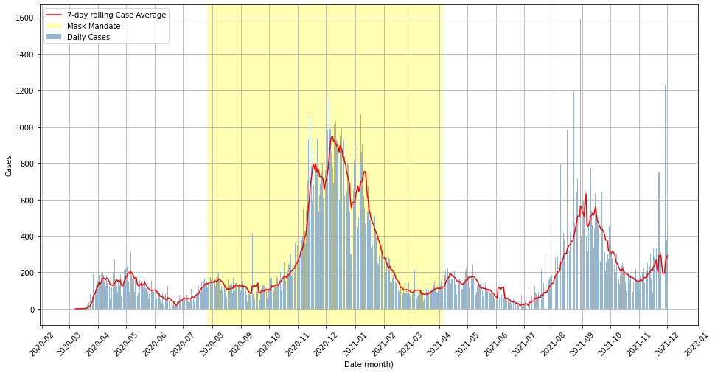
COVID-19 Cases – Marion County, IN March 1, 2020 – December 1, 2021
Notes:
Multiple waves, headed back up right now, doesn’t appear strictly seasonal but clearly some kind of cycle.
Peak of cases in ~December 2020 slowed down too late to be attributed to mask mandate – what happened here?

Slide 3
Research Question & Hypothesis
Investigate how availability of ICU beds and ventilators impacted COVID-19 outcomes in Marion County, IN
Specifically interested in any link between increased Case Fatality or Vaccination Rate after periods of peak hospitalizations
Using hospitalizations as the baseline instead of cases because this is assumed to be a more robust metric
Notes:
Specifically looking to investigate how a real OR perceived threat from COVID-19 impacts human behavior
Outcomes = deaths & vaccinations

Slide 4
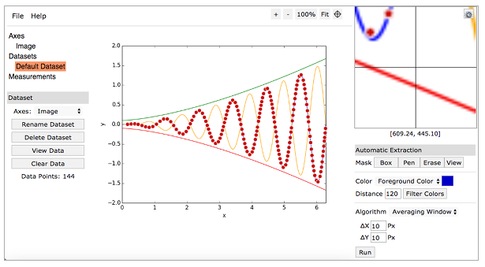
Data Dictionary & Sources
Daily COVID-19 cases & deaths from JHU
Vaccination data & occupancy rates from the Indiana Department of Health (IDOH)
Hospitalizations from Marion County Health Department dashboard
NOTE: WebPlotDigitizer was used to scrape hospitalization data.
Notes:
Biases?

Slide 5

Definitions
Case Fatality Rate: proportion of people diagnosed with a certain disease who end up dying of it
$CFR=\frac{Deaths at day X}{Cases at day (X −a)}$ where $a$ is some constant lag value
Potential Problems: very sensitive to choice of $a$
https://en.wikipedia.org/wiki/Case_fatality_rate
https://www.ncbi.nlm.nih.gov/pmc/articles/PMC7569625/

Slide 6
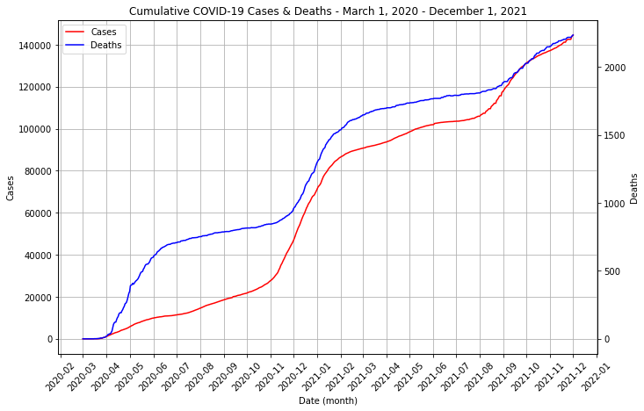

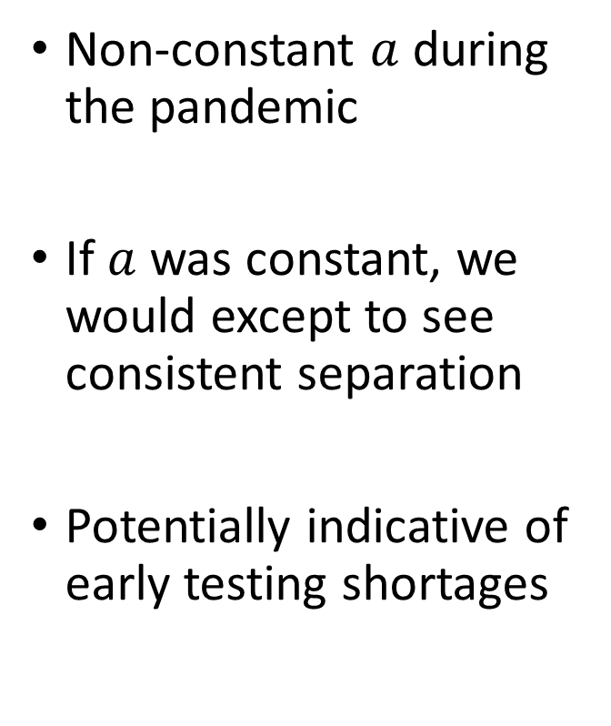
Investigating $a$and Case Fatality Rate
Non-constant $a$ during the pandemic
If $a$was constant, we would except to see consistent separation
Potentially indicative of early testing shortages
NOTE: plot has a double y-axis.
Notes:
Tried pushing forward anyway with some estimates of A based on reporting from the CDC & IDOH, not very informative, chose to pivot
EMPHASIZE TWO Y-AXES

Slide 7
Stationarity & Pearson R
Augmented Dickey-Fuller test – reject H0 if stationary
7-day rolling average helps correct for seasonality
Hospitalizations are a stronger predictor of COVID-19 deaths than case count
 | Daily Count p-value | Rolling Avg. p-value
Cases | 0.231 | 0.097
Hospitalizations | N/A | 0.037
Deaths | 0.184 | 0.030
 | Pearson R | p-value
Cases-Deaths | 0.533 | <0.001
Hospitalizations-Deaths | 0.631 | <0.001

Slide 8
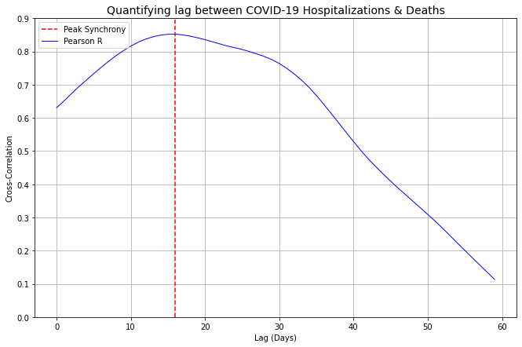
Time-Lagged Cross Correlation
Correlation is maximized at 0.852 with a 16-day lag between COVID-19 hospitalizations & deaths
Can help to inform disease progression & hospital occupancy rates

Slide 9
Evidence for Overcrowding
Emergency room diversion statistics are not public
Local news stories on diversions begin appearing in late-August 2021, right as Marion County is entering a second wave of COVID-19 infections due to the Delta variant
Area hospitals delayed elective procedures through September 2021
https://www.usnews.com/news/best-states/indiana/articles/2021-09-08/covid-19-patients-strain-indiana-hospitals-as-virus-surges
https://www.wthr.com/article/news/verify/yes-many-indianapolis-area-hospitals-have-been-turning-away-ambulances-because-their-ers-and-icus-are-too-full-verify/531-28e2216c-dc3f-4b4d-ae3c-f02f30634439
Notes:
At one point 11 of 13 area hospitals were operating on diversion due to lack of beds, staffing shortages, and an influx of COVID-19 patients

Slide 10
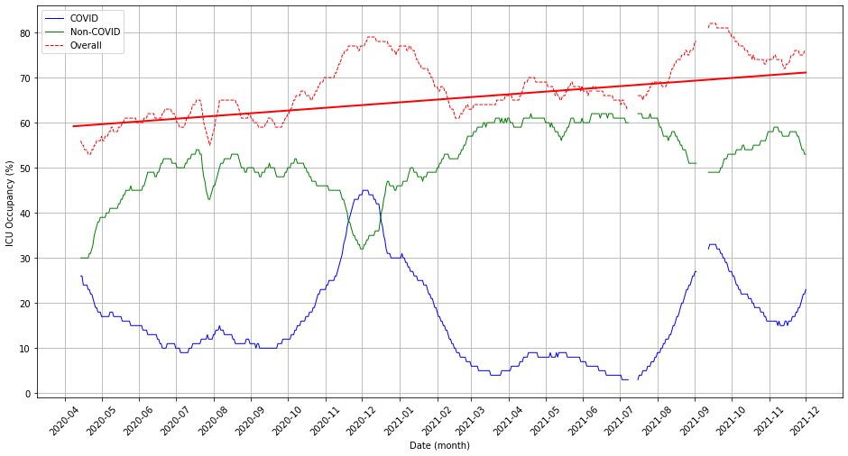
COVID-19 caused spikes in ICU Occupancy
NOTE: represents state-level occupancy rate.
Notes:
Occupancy can be misleading because less-critical patients may be admitted if there is room.
Nevertheless, still seeing increased ICU occupancy over the course of the pandemic, second wave saw higher capacity than the first but with higher capacity (still below baseline) of non-COVID patients.

Slide 11
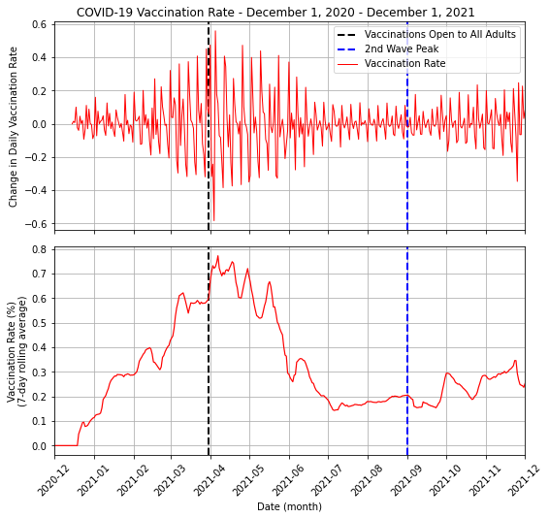
Did this drive a change in behavior?
Second wave peaked during late August, this surge in cases has driven a slight uptick in vaccination rate
Difficult to tell if this trend holds without further data
Indiana has tried to limit enactment & enforcement of vaccine mandates
Notes:
Possible confounding factor due to vax mandates – pretty unlikely in IN

Slide 12
Implications & Further Analysis
Too many unknowns to measure change in Case Fatality Rate over time with only aggregate data
After initial rush on vaccinations, some evidence that subsequent increases in vaccination rate followed COVID-19 infection waves
Can be used to influence public messaging on vaccinations & better anticipate ICU staffing needs

